Slide 1
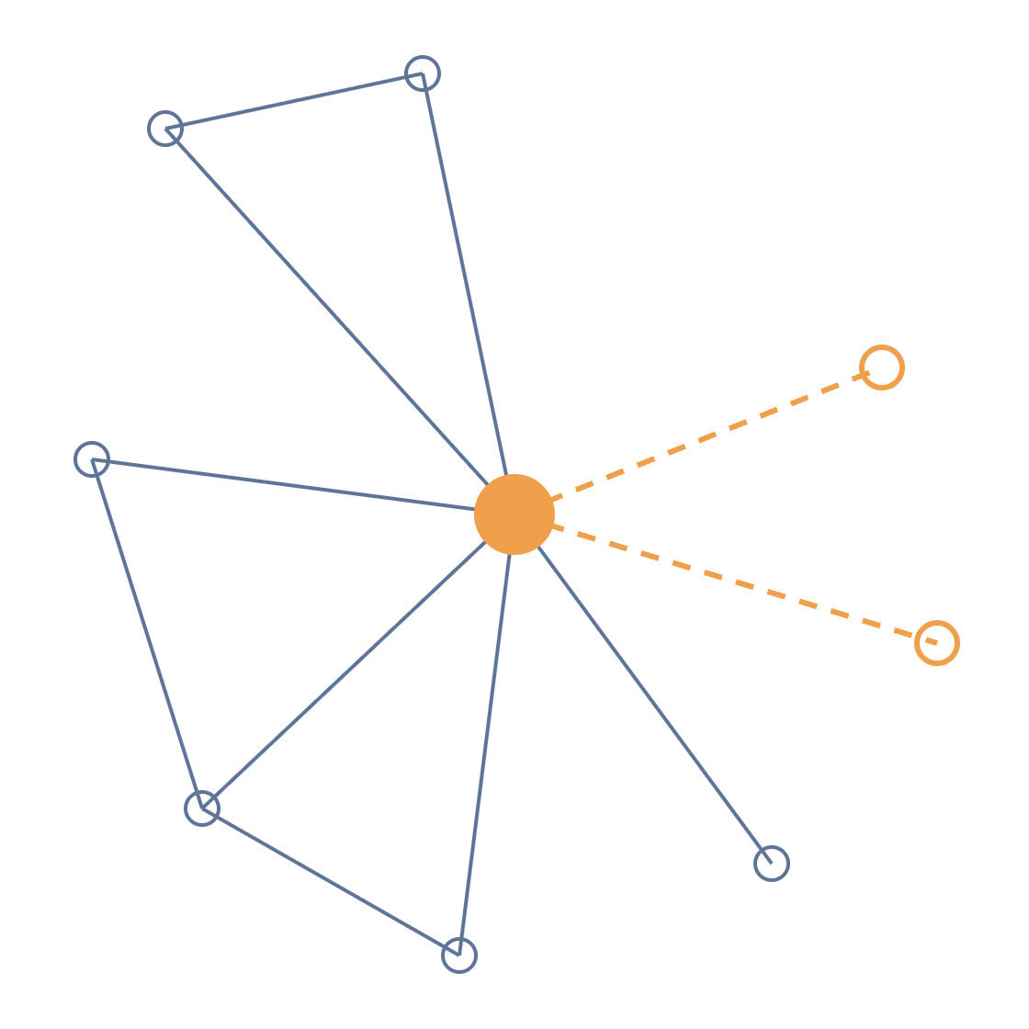
AML Alert System
CS611 MACHINE LEARNING ENGINEERING · FINAL PRESENTATION
Ranking suspicious bank accounts every morning, with reasons an investigator can check
Group 9 · Zhou Jie · Ho Wee Loong · Joyce Teo Hua Sze · Abinav Shajil · Alekhya Kodavatiganti · Zachary Artemus Kondas
Notes:
Good morning. We are Group 9. In the proposal we promised an alert system that ranks bank accounts by money laundering risk. Today we show the working system: a daily pipeline on Airflow, models tracked in MLflow, a batch alert list and a real-time API, and a monitor that already caught drift. About 10 minutes, then a short demo if time allows.

Slide 2
Investigators need a ranked list
WHY IT MATTERS
Rules are noisy
Time is scarce
Reasons required
"Amount above 10,000" gives 1.37M alerts at 0.18% precision on our data.
An investigator can only open a fixed number of cases a day.
MAS FEAT: an AI-assisted alert must be explainable and accountable.
WHAT WE BUILT
Every morning, the 500 riskiest accounts with three reasons each. Any time, an API to score one account.
Used by AML investigators (alert list, API), compliance managers (precision and volume) and ML engineers (registry, drift).
AML Alert System · Final Presentation
2
Notes:
Quick recap of the problem. Banks in Singapore must monitor transactions under MAS Notice 626. Fixed rules are noisy: on our data the classic "amount above 10,000" rule raises 1.37 million alerts with 0.18% precision. Investigators can only open so many cases, and MAS FEAT expects every AI-assisted alert to be explainable. So the product is a ranked list: each morning the 500 riskiest accounts, each with three reasons, plus an API for one-off checks.

Slide 3
What we changed after your feedback
SINCE THE RFC
Feedback at the RFC | What we did
Did you compare other models? | LR baseline, LightGBM, LightGBM + graph on the same days
How do you handle the imbalance? | Class weights made ranking ~10× worse, so we rank and report P@K
Use the links between accounts | 6 graph features: PageRank, payment loops, 2-hop fan-in / fan-out
How do batch and online connect? | Both read one feature store and one champion model alias
Why SHAP? | Per-account reasons that add up to the score, exact for trees
Out-of-time validation? | Train, valid and test are different days; test used once
Also changed: HI-Large to HI-Small, so the whole pipeline runs on one laptop · XGBoost to LightGBM (native SHAP values, faster early stopping).
AML Alert System · Final Presentation
3
Notes:
Your RFC feedback shaped the build, so here is what we did with it. We now compare three models instead of only XGBoost. On imbalance, we actually tested class weights and they made the ranking about ten times worse, so we rank accounts and report precision at K. Several of you suggested using relationships between accounts: we added six graph features. The architecture now shows how batch and online connect. And we explain why SHAP and how we split by time. Two other changes: HI-Small instead of HI-Large so it runs on a laptop, and LightGBM instead of XGBoost.

Slide 4
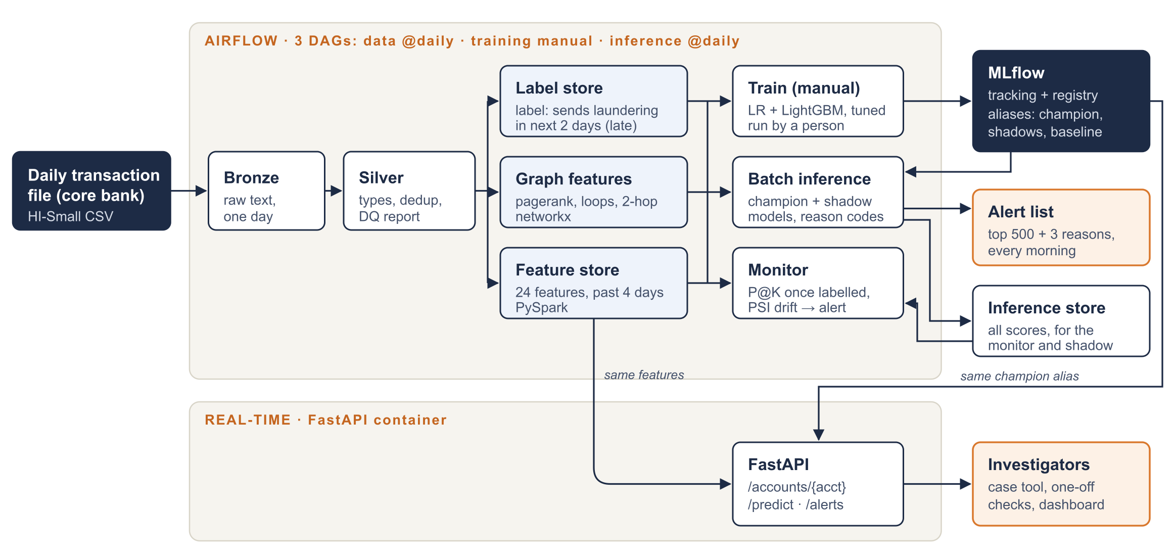
Three DAGs, two ways to get a score
ARCHITECTURE
One command
docker compose up starts Airflow, MLflow and the API
Three DAGs
Data daily, training by hand, inference daily; they share only the stores
Same score
Batch list and API share the features and the champion alias
AML Alert System · Final Presentation
4
Notes:
This is the whole system, in three Airflow DAGs. The data DAG runs every day: bronze and silver ingest the day's transactions, then three gold stores: account features in PySpark, graph features in networkx, and labels. The training DAG has no schedule. A person runs it, for the first models or after a drift alert, and it registers the models in MLflow. The inference DAG runs every morning: it loads the champion and the shadow models from MLflow, writes the alert list, keeps every score, then runs the monitor. The three DAGs only talk through the stores, the same split into feature, training and inference pipelines we saw in Session 7. At the bottom, the FastAPI service. The key point for the feedback: the API does not compute its own features; it reads the same feature store and loads the same champion alias, so both give the same score. Locally everything starts with docker compose up, and replaying the ten days takes about ten minutes.

Slide 5
Features look back, labels look forward
DATA DESIGN
Sep
1
2
3
4
5
6
7
8
9
10
Train
24 account features · PySpark
Sent and received activity, amount percentiles per currency, ACH / cash / bitcoin shares, reciprocal pairs, recency
Valid
Test
6 graph features · networkx
Features: 4 days before the snapshot
Label: sends laundering in next 2 days
PageRank, payment-loop size, 2-hop fan-in and fan-out
Labels arrive two days late, so each daily run builds tomorrow's features and closes the labels of yesterday's snapshot. Sep 11-18 is left out: legit volume collapses there.
Leakage checks
Percentiles only inside the window · label windows never overlap · Spark output equals the EDA prototype
AML Alert System · Final Presentation
5
Notes:
This answers the out-of-time question. Every snapshot is a morning. Features use only the four days before it, in blue. The label, in orange, is whether the account sends a laundering payment in the next two days. Train, validation and test are three different mornings, and their label windows never overlap, so nothing from the future leaks into training. Because labels arrive two days late, each daily run builds tomorrow's features and closes yesterday's labels. Per account we have 24 features from PySpark and 6 graph features. We checked that the Spark pipeline reproduces our EDA prototype exactly.

Slide 6
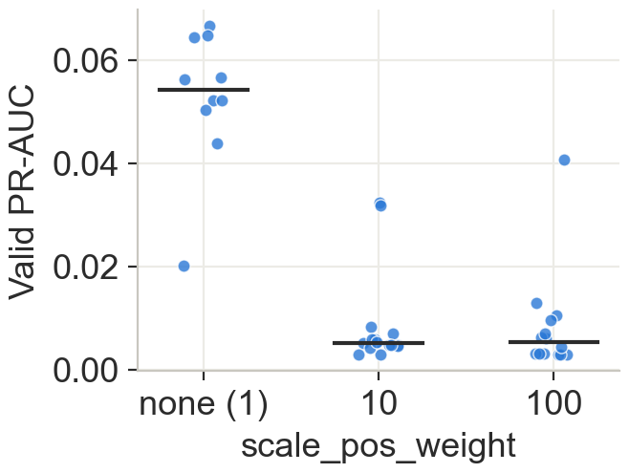
Three models, tuned on the validation day
MODEL DEVELOPMENT
Model | PR-AUC | P@500 | Role
Logistic regression | 0.042 | 5.8% | baseline
LightGBM | 0.065 | 9.4% | champion
LightGBM + graph | 0.067 | 10.4% | challenger
Selection rule
The simplest model within 10% of the best PR-AUC goes live. Graph features gave +3%, which is noise with 565 positives, and cost an extra daily job.
No class weights: weighting the positives cut validation PR-AUC about 10 times (median 0.054 to 0.005).
20-try random search with early stopping per LightGBM · every try logged in MLflow · 2 minutes on a laptop CPU
AML Alert System · Final Presentation
6
Notes:
Three models on exactly the same snapshots: logistic regression as the simple baseline, LightGBM, and LightGBM with the graph features. Each LightGBM gets a 20-try random search with early stopping on the validation day, and every try is logged in MLflow. On the right is the imbalance answer: we put class weights into the search, and every weighted try was far worse, about ten times lower PR-AUC. So we keep the natural class balance and measure with precision at K. On validation the graph model was only 3% better, which is noise with 565 positives, so our rule picks the simpler LightGBM as champion and keeps the graph model in shadow.

Slide 7

Releasing a model means moving an alias
MODEL REGISTRY · SHADOW DEPLOYMENT
champion
challenger
baseline
v2 · LightGBM
v3 · LightGBM + graph
v1 · Logistic regression
Production: morning alert list and the API
Shadow: scored every day, never shown
Benchmark: drawn against both at every training
Drift alert: a person runs the training DAG
Two new versions run in shadow
Shadow results checked when labels arrive
One command promotes, logs who and why
API reloads, no restart
Rollback is the same command with the old version. Tested while the API kept serving.
AML Alert System · Final Presentation
7
Notes:
All models live in one MLflow registered model. Nothing in the code points to a file; it points to an alias. The champion feeds the alert list and the API. The challenger is scored every day but never shown: that is our shadow deployment. The baseline, logistic regression, is not scored every day; each training run draws the champion and the challenger against it, so we can see they are clearly better. Retraining is never automatic: when the monitor raises a drift alert, a person decides whether to run the training DAG. Its two new models only run in shadow, next to the champion, and the old challenger stops. The rule for better is written down: at least three labelled days with higher precision at 500, and no other metric worse. When a shadow model meets it, a person runs one command, model promote. It gives one new model the champion alias and the other the challenger alias, records who did it and why, and tells the API to reload. The API also checks the alias every minute, so every API container follows. Then it is one champion and one challenger again. It works like a blue-green switch, and rollback is the same command with the old version. We tested promotion and rollback while the API was running.

Slide 8
Same score from the morning list and the API
DEPLOYMENT · BATCH AND REAL-TIME
Batch · every morning, top 500
API · any time
# | Account | Score | Top reason
1 | 811D80C30 | 0.447 | money goes both ways with 3 accounts
2 | 80C6F48A0 | 0.336 | received from 8 different banks
3 | 8010D4440 | 0.255 | last payment 1 hour ago
GET /accounts/811D80C30
score 0.4467 · alert rank 1
model version 2
"100% of sent payments are ACH"
"money goes both ways with 3 accounts"
"last payment 4 hours ago"
All three were laundering accounts. Champion and challenger scores are both kept for the monitor.
250k accounts
5 ms
Stateless
scored by the batch job in seconds
per API lookup after the first call
API container scales out behind a load balancer
AML Alert System · Final Presentation
8
Notes:
Two doors, one model. On the left, the morning list from the batch job in the inference DAG: account, score and reasons. These are the top three accounts on September 9, and all three were real laundering accounts. The challenger is scored on the same accounts and kept for the monitor, but never shown. On the right, the same account through the API: same score, 0.4467, same reasons, and it tells the investigator the account is already rank one in today's list. The batch job scores 250 thousand accounts in seconds; the API answers in about 5 milliseconds after it caches the snapshot. The API keeps no state of its own, so it can scale out.

Slide 9
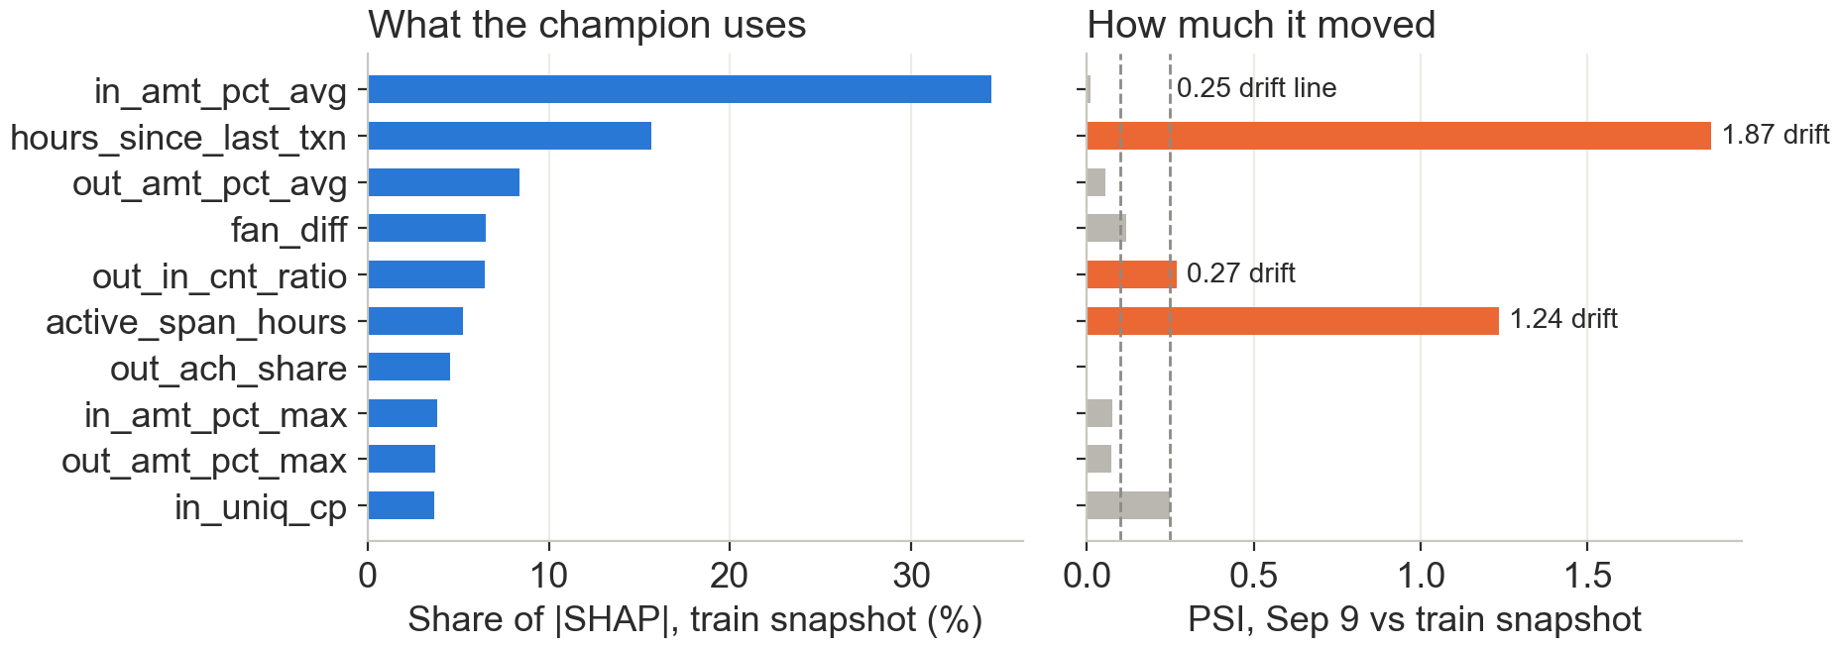
The monitor caught real drift on day one
MONITORING
Why: the training window (Thu-Sun) has a weekend, Sep 9's window (Mon-Thu) does not, so recency features shift. Drift alert, a person ran the training DAG, new v5 and v6 wait in shadow.
AML Alert System · Final Presentation
9
Notes:
The monitor runs after every batch, in the inference DAG. It checks model quality when labels arrive, data drift and score drift with PSI, feature attribution drift with SHAP shares, and data quality. On the left, what the champion relies on: mostly how large the received amounts are, then recency. ACH is only 5%, less than we feared from the EDA. On the right, the first production day: hours since last transaction moved a lot, PSI 1.87. The cause is the calendar: our training window included a weekend and the test window did not. The monitor does not retrain by itself. It writes a drift alert as an error in the log and in an alert file, and a person decides. We reviewed it and ran the training DAG; its two new models, versions 5 and 6, now run in shadow next to the champion, and the training chart shows them well above the logistic regression baseline.

Slide 10
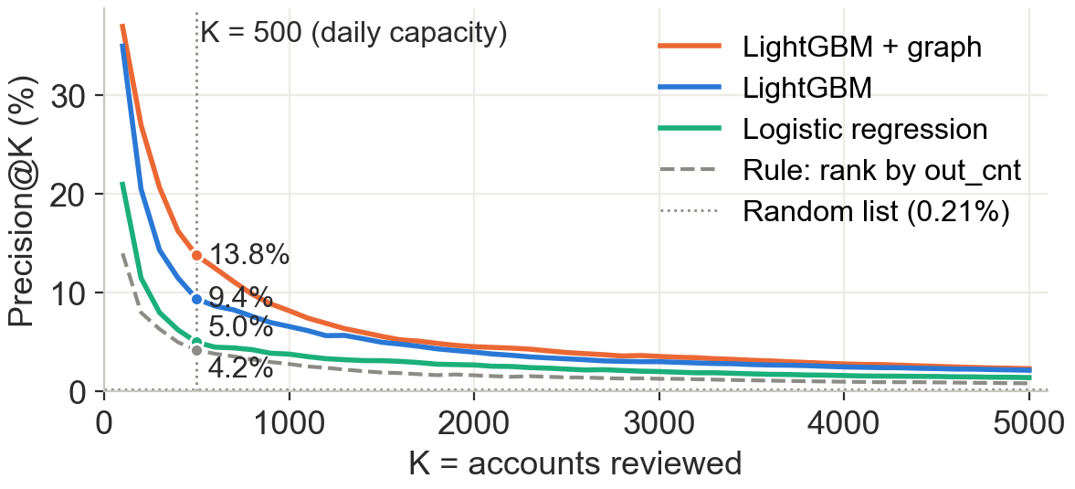
47 laundering accounts in the top 500
RESULTS · TEST DAY SEP 9 · 534 LAUNDERERS IN 253K ACCOUNTS
9 of 10
top accounts were laundering
2.2×
the best rule in the top 500 (47 vs 21)
69
in the shadow challenger's top 500: +4.2 points, 95% CI 2.2-6.2
AML Alert System · Final Presentation
10
Notes:
Now the results on the test day, September 9, which the monitor evaluated once, when its labels arrived. The champion's list of 500 held 47 laundering accounts: 2.2 times the best rule and 45 times a random list. The top is very dense: 9 of the first 10 accounts. The blue line is the champion. The orange line is the shadow challenger with graph features: 69 accounts in its top 500, plus 4.2 points, and the paired bootstrap interval is 2.2 to 6.2 points. So on this day the graph features clearly helped, even though they did not on validation. That is exactly why we ran it in shadow first.

Slide 11
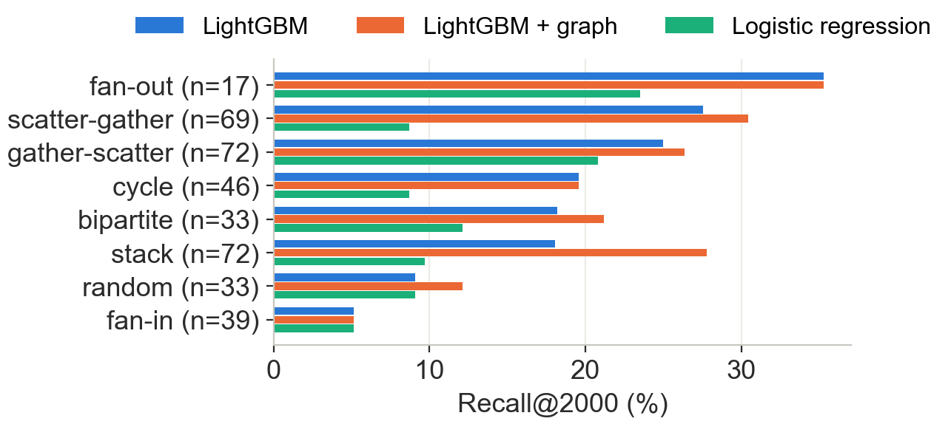
Good on fan-out and layering, weak on fan-in
WHAT WE CATCH · RECALL@2000 BY PATTERN
Graph features help on layers
Stack 18% to 28%, bipartite 18% to 21%: patterns only visible in the neighbourhood
Fan-in stays hard: 5%
Each source sends one normal-looking payment
Ceiling: 75%
1 in 4 launderers had no activity in the past 4 days, no model can score them
AML Alert System · Final Presentation
11
Notes:
IBM's pattern file lets us ask which laundering patterns we catch. At 2,000 accounts we catch a third of fan-out and a quarter of the gather and scatter patterns. Graph features matter most on stack and bipartite, the layered patterns you only see in an account's neighbourhood. Fan-in is the weak spot: each source sends one ordinary payment, and nothing at account level gives it away. And there is a hard ceiling: a quarter of the launderers had no activity in the four days before, so no model on these features can score them.

Slide 12
What we would do with real data
LIMITS AND NEXT STEPS
Limits
Next
Synthetic data: the ACH signal is a simulator quirk
One labelled test day, about 550 positives
4-day windows mix weekdays and weekends
25% of launderers have no recent activity
Investigator decisions as labels (feedback loop)
7-day or volume-normalised features
KYC and onboarding data for new accounts
Run on AWS: MWAA, EMR, S3, ECS with RDS
OUR RECOMMENDATION
Keep the graph model in shadow for a few more labelled days. If it keeps beating the champion, move the alias: no code change, no downtime.
AML Alert System · Final Presentation
12
Notes:
Some honest limits. The data is synthetic, and signals like the ACH share come from the simulator. We have one labelled test day, so the intervals are wide. Our four-day windows mix weekdays and weekends, which caused the drift we saw. And a quarter of launderers have no recent history. With real data we would use investigator decisions as labels, use seven-day or volume-normalised features, add KYC data for new accounts, and move the same containers to AWS. Our recommendation: keep the graph model in shadow a few more days, and if it keeps winning, promote it by moving the alias.

Slide 13
Thank you
AML ALERT SYSTEM · FINAL PRESENTATION
Questions and feedback are welcome.
AIRFLOW
MLFLOW
API
CODE
localhost:8081
localhost:5001
localhost:8000/docs
github.com/Alekhya-koda/Anti-Money-Laundering
Notes:
Thank you. If there is time, a quick demo: the Airflow DAG with ten green runs, the model versions and aliases in MLflow, and an API call for the top account. Happy to take questions.

